Slide 1
Some other Positional Measure

Slide 2
Median is the most important positional measure. It divides the whole distribution into two equal parts. That is 50% observations are equal to or smaller than median and 50% observations are equal to or larger than the median . Other important positional measures are
Quartiles
Deciles
Percentiles
In general, Quartiles, Deciles and Percentiles are all known as quartiles.

Slide 3
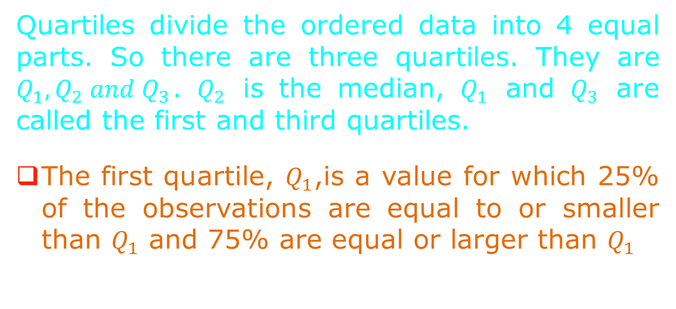
Quartiles
Quartiles divide the ordered data into 4 equal parts. So there are three quartiles. They are $Q_{1},Q_{2} and Q_{3}$.$Q_{2}$ is the median, $Q_{1}$ and $Q_{3}$ are called the first and third quartiles.
The first quartile, $Q_{1}$,is a value for which 25% of the observations are equal to or smaller than $Q_{1}$ and 75% are equal or larger than $Q_{1}$

Slide 4
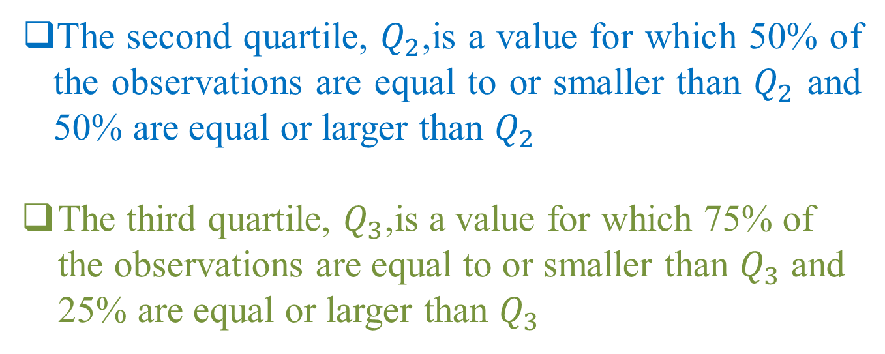
The second quartile, $Q_{2}$,is a value for which 50% of the observations are equal to or smaller than $Q_{2}$ and 50% are equal or larger than $Q_{2}$
The third quartile, $Q_{3}$,is a value for which 75% of the observations are equal to or smaller than $Q_{3}$ and 25% are equal or larger than $Q_{3}$

Slide 5
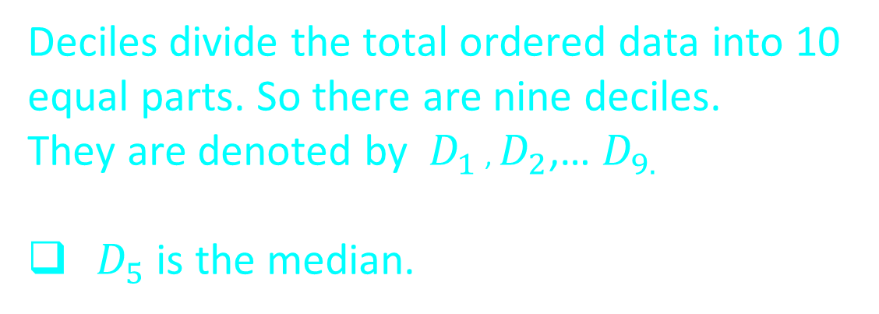
Deciles
Deciles divide the total ordered data into 10 equal parts. So there are nine deciles.
They are denoted by $D_{1}$ , $D_{2}$,… $D_{9.}$
$D_{5}$is the median.

Slide 6
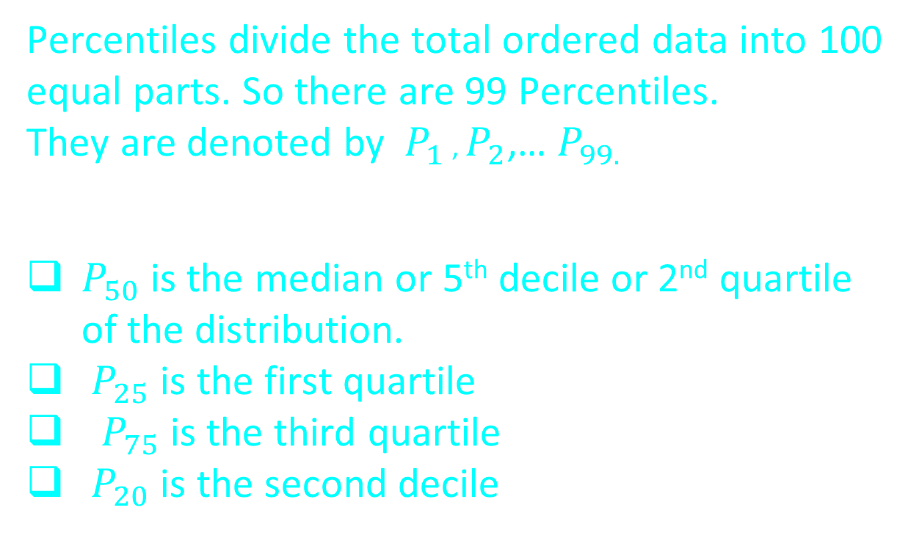
Percentile
Percentiles divide the total ordered data into 100 equal parts. So there are 99 Percentiles.
They are denoted by $P_{1}$ , $P_{2}$,… $P_{99.}$
$P_{50}$is the median or 5th decile or 2nd quartile of the distribution.
$P_{25}$is the first quartile
$P_{75}$is the third quartile
$P_{20}$is the second decile

Slide 7
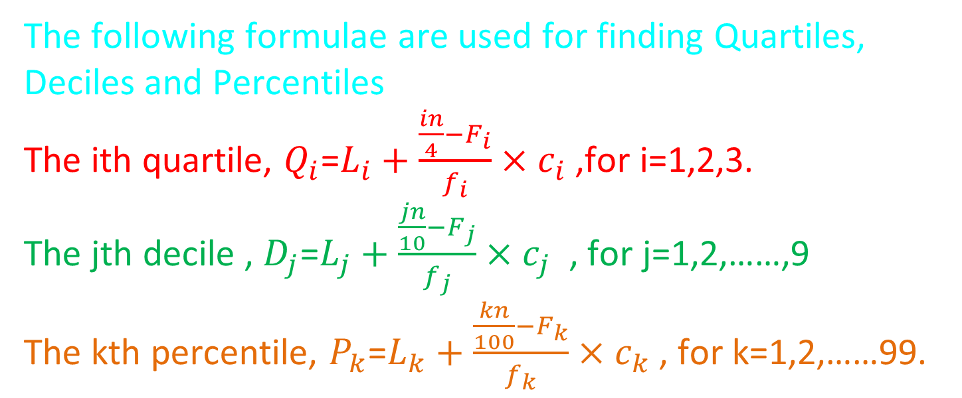
Computation of Quartiles, Deciles and Percentiles from grouped data of continuous type
The following formulae are used for finding Quartiles, Deciles and Percentiles
The ith quartile, $Q_{i}$=$L_{i}+\frac{\frac{in}{4}−F_{i}}{f_{i}}×c_{i}$ ,for i=1,2,3.
The jthdecile , $D_{j}$=$L_{j}+\frac{\frac{jn}{10}−F_{j}}{f_{j}}×c_{j}$ , for j=1,2,……,9
The kth percentile, $P_{k}$=$L_{k}+\frac{\frac{kn}{100}−F_{k}}{f_{k}}×c_{k}$ , for k=1,2,……99.

Slide 8
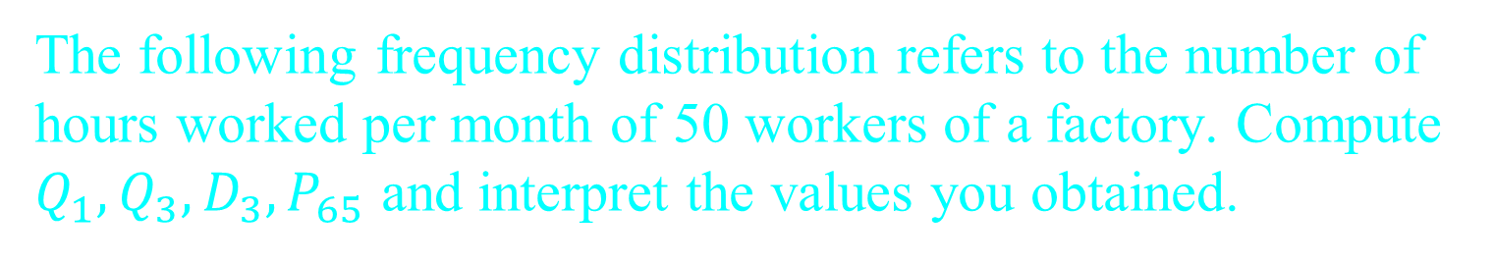
Example
The following frequency distribution refers to the number of hours worked per month of 50 workers of a factory. Compute $Q_{1}, Q_{3}, D_{3},P_{65}$ and interpret the values you obtained.
No. of hours worked per month | Frequency
30-55 | 3
55-80 | 4
80-105 | 6
105-130 | 9
130-155 | 12
155-180 | 11
180-205 | 5

Slide 9
Solution
Class | Frequency f | Cumulative frequency F
30-55 | 3 | 3
55-80 | 4 | 7
80-105 | 6 | 13
105-130 | 9 | 22
130-155 | 12 | 34
155-180 | 11 | 45
180-205 | 5 | 50
Total | n =50

Slide 10
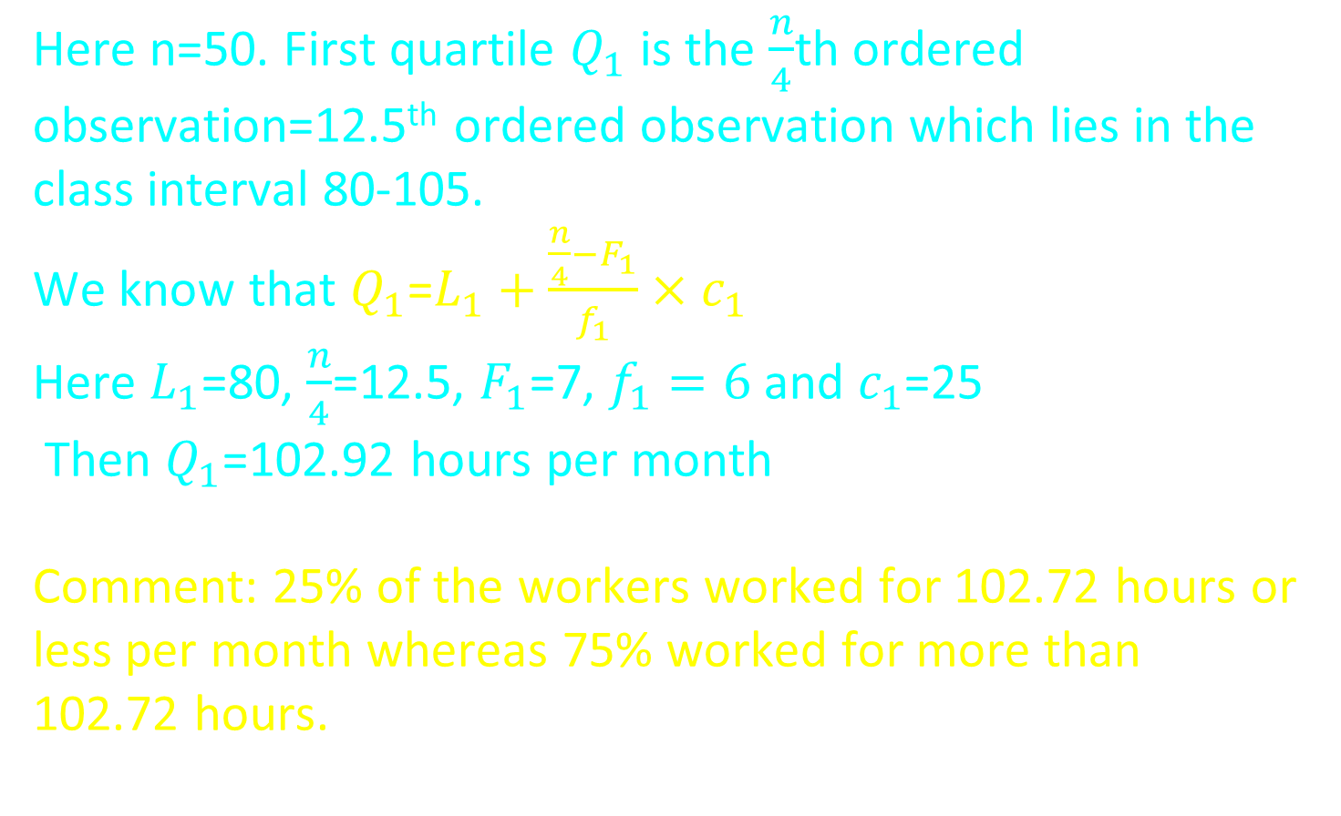

First Quartile $Q_{1}$
Here n=50. First quartile $Q_{1}$ is the $\frac{n}{4}$th ordered observation=12.5th ordered observation which lies in the class interval 80-105.
We know that $Q_{1}$=$L_{1}+\frac{\frac{n}{4}−F_{1}}{f_{1}}×c_{1}$
Here $L_{1}$=80, $\frac{n}{4}$=12.5, $F_{1}$=7, $f_{1}=6$ and $c_{1}$=25
Then $Q_{1}$=102.92 hours per month
Comment: 25% of the workers worked for 102.72 hours or less per month whereas 75% worked for more than 102.72 hours.

Slide 11
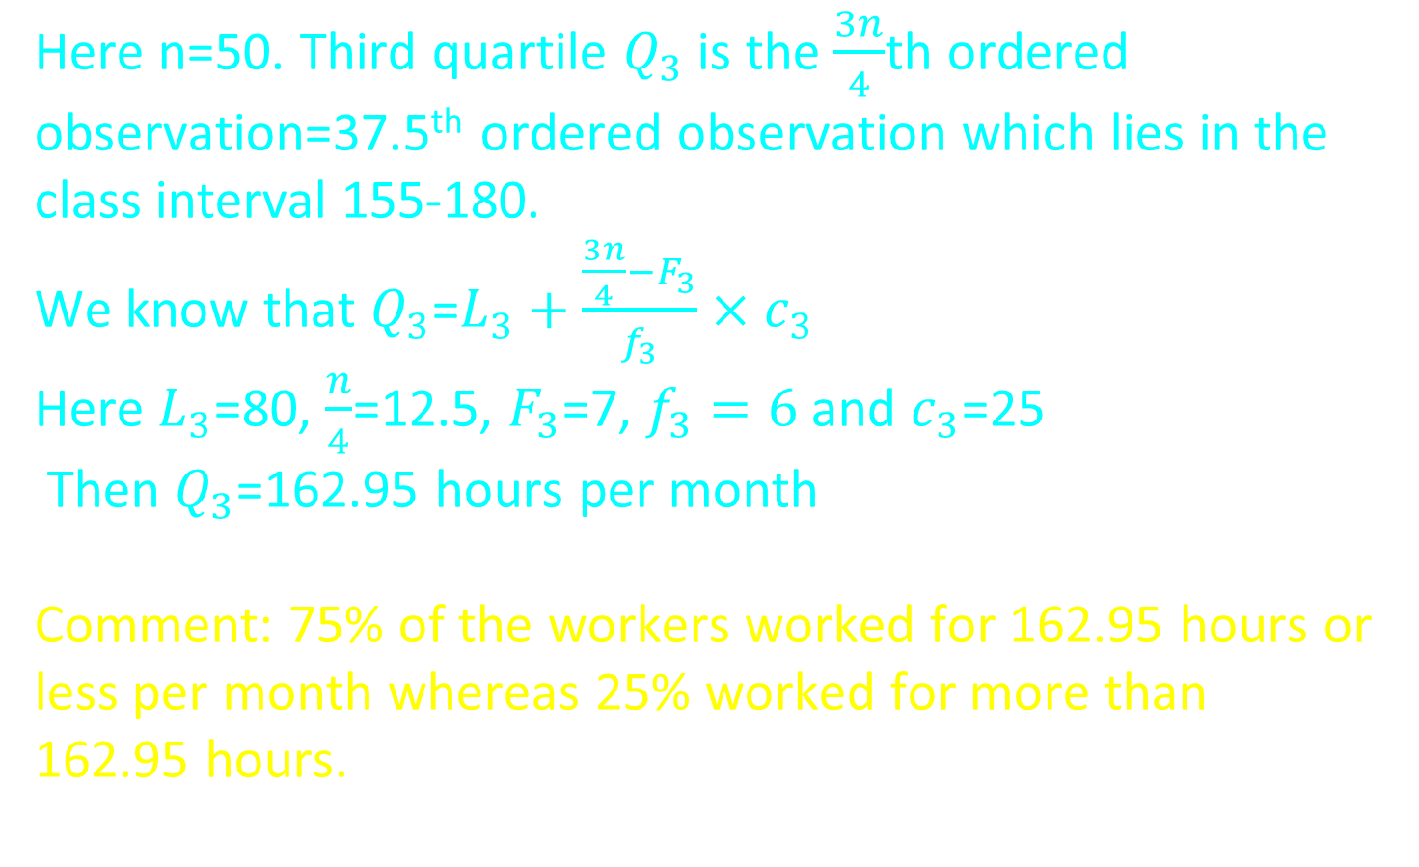

Third Quartile $Q_{3}$
Here n=50. Third quartile $Q_{3}$ is the $\frac{3n}{4}$th ordered observation=37.5th ordered observation which lies in the class interval 155-180.
We know that $Q_{3}$=$L_{3}+\frac{\frac{3n}{4}−F_{3}}{f_{3}}×c_{3}$
Here $L_{3}$=80, $\frac{n}{4}$=12.5, $F_{3}$=7, $f_{3}=6$ and $c_{3}$=25
Then $Q_{3}$=162.95 hours per month
Comment: 75% of the workers worked for 162.95 hours or less per month whereas 25% worked for more than 162.95 hours.

Slide 12
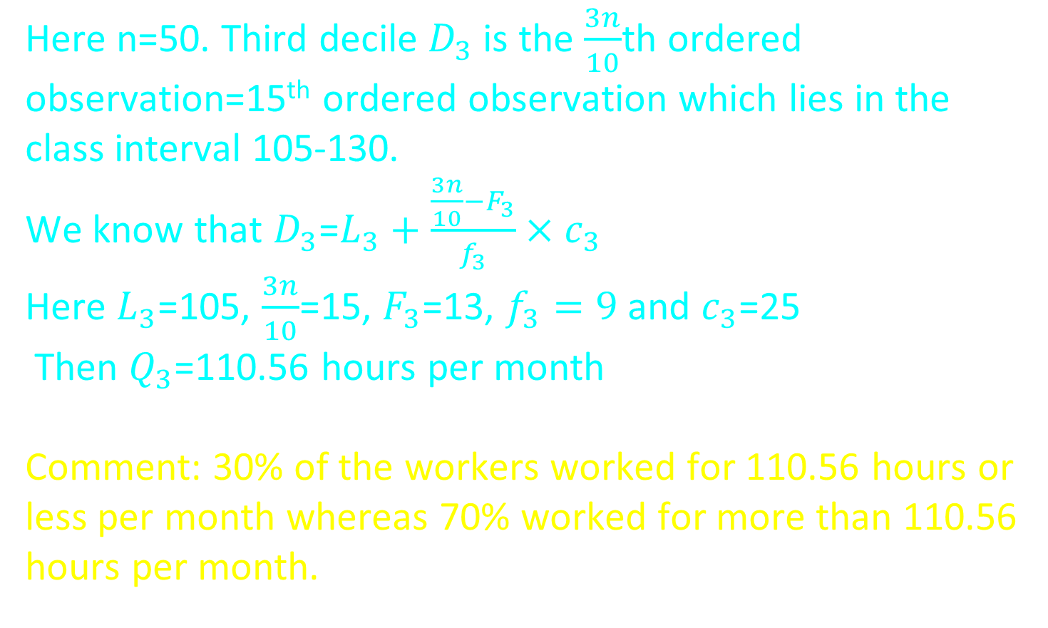
Third Decile
Here n=50. Third decile $D_{3}$ is the $\frac{3n}{10}$th ordered observation=15th ordered observation which lies in the class interval 105-130.
We know that $D_{3}$=$L_{3}+\frac{\frac{3n}{10}−F_{3}}{f_{3}}×c_{3}$
Here $L_{3}$=105, $\frac{3n}{10}$=15, $F_{3}$=13, $f_{3}=9$ and $c_{3}$=25
Then $Q_{3}$=110.56 hours per month
Comment: 30% of the workers worked for 110.56 hours or less per month whereas 70% worked for more than 110.56 hours per month.

Slide 13
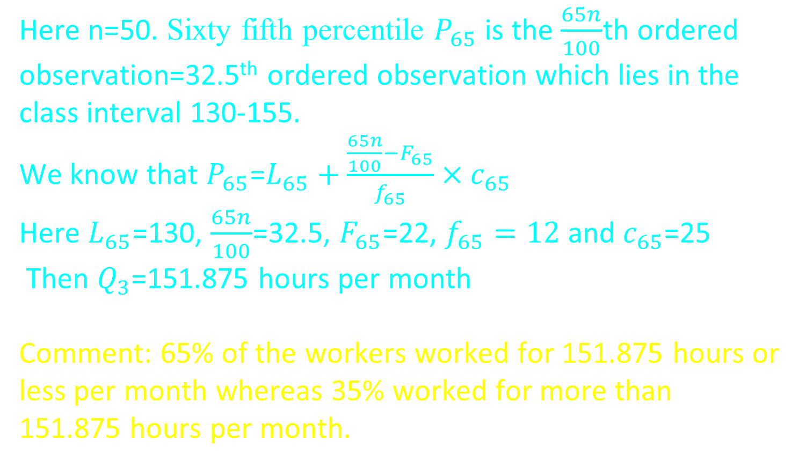
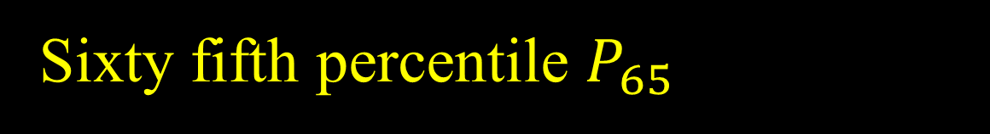
Sixty fifth percentile $P_{65}$
Here n=50. Sixty fifth percentile $P_{65}$ is the $\frac{65n}{100}$th ordered observation=32.5th ordered observation which lies in the class interval 130-155.
We know that $P_{65}$=$L_{65}+\frac{\frac{65n}{100}−F_{65}}{f_{65}}×c_{65}$
Here $L_{65}$=130, $\frac{65n}{100}$=32.5, $F_{65}$=22, $f_{65}=12$ and $c_{65}$=25
Then $Q_{3}$=151.875 hours per month
Comment: 65% of the workers worked for 151.875 hours or less per month whereas 35% worked for more than 151.875 hours per month.

Slide 14
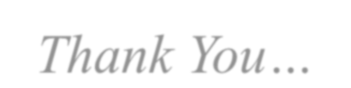

Thank You… ☺ ☺

